Slide 1

Lungs Diseases Detection System Using Machine Learning
For
TECHNO CRAT 2k24
CODE_AKATSUKI

Slide 2
CODE_AKATSUKI
Point to be discussed
01 Problem Statement
02 Our Key Features
03 Project working
04 Market Analysis
05 Doctor Consultation

Slide 3

Problem Statement
CODE_AKATSUKI
Lack of Early Detection Tools
Resource Constraints and Workload on Healthcare Professionals.
Data Variability and Complexity in Radiological Images
Limited Accessibility to Advanced Technologies
Traditional methods have high false positive rates

Slide 4
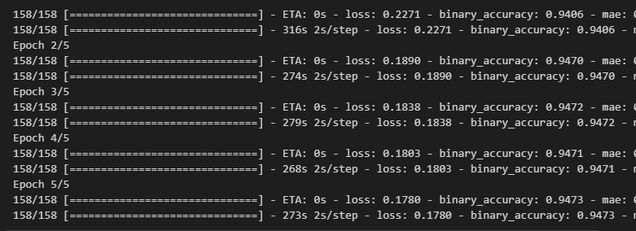
Robust Data Handling
Resource-Efficient Workflow.
Continuous Learning and Improvement.
Automated Early Detection.
User-Friendly Interface
Feature Extraction from Radiological Images
Mobile and Web Accessibility
Cost-Efficient Scalability
Advanced machine learning techniques are employed to handle the variability and complexity inherent in radiological images, ensuring accurate detection across diverse datasets and reducing false positives.
Traditional system cost :
It have the effectiveness of screening method like LDCT , chest X-ray , PTE Scan
But the its very expensive 2000.Rs up-to 50000.Rs .
Our system cost :
Affordable Maintains and operating cost
No other resources
C
Our Features And Solution on Problem
B
A

Slide 5

About Project Technology
CODE_AKATSUKI
Algorithm : Supervised learning
Platform : Web Based Application
Framework: Django (Python Framework)
Dataset : World health organization (WHO)
About 30,000 patients across 1,00,000 images

Slide 6
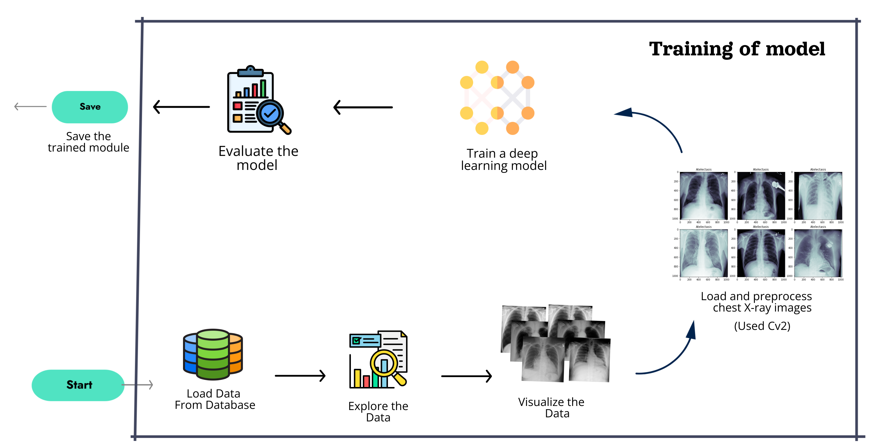
Training Model
CODE_AKATSUKI

Slide 7
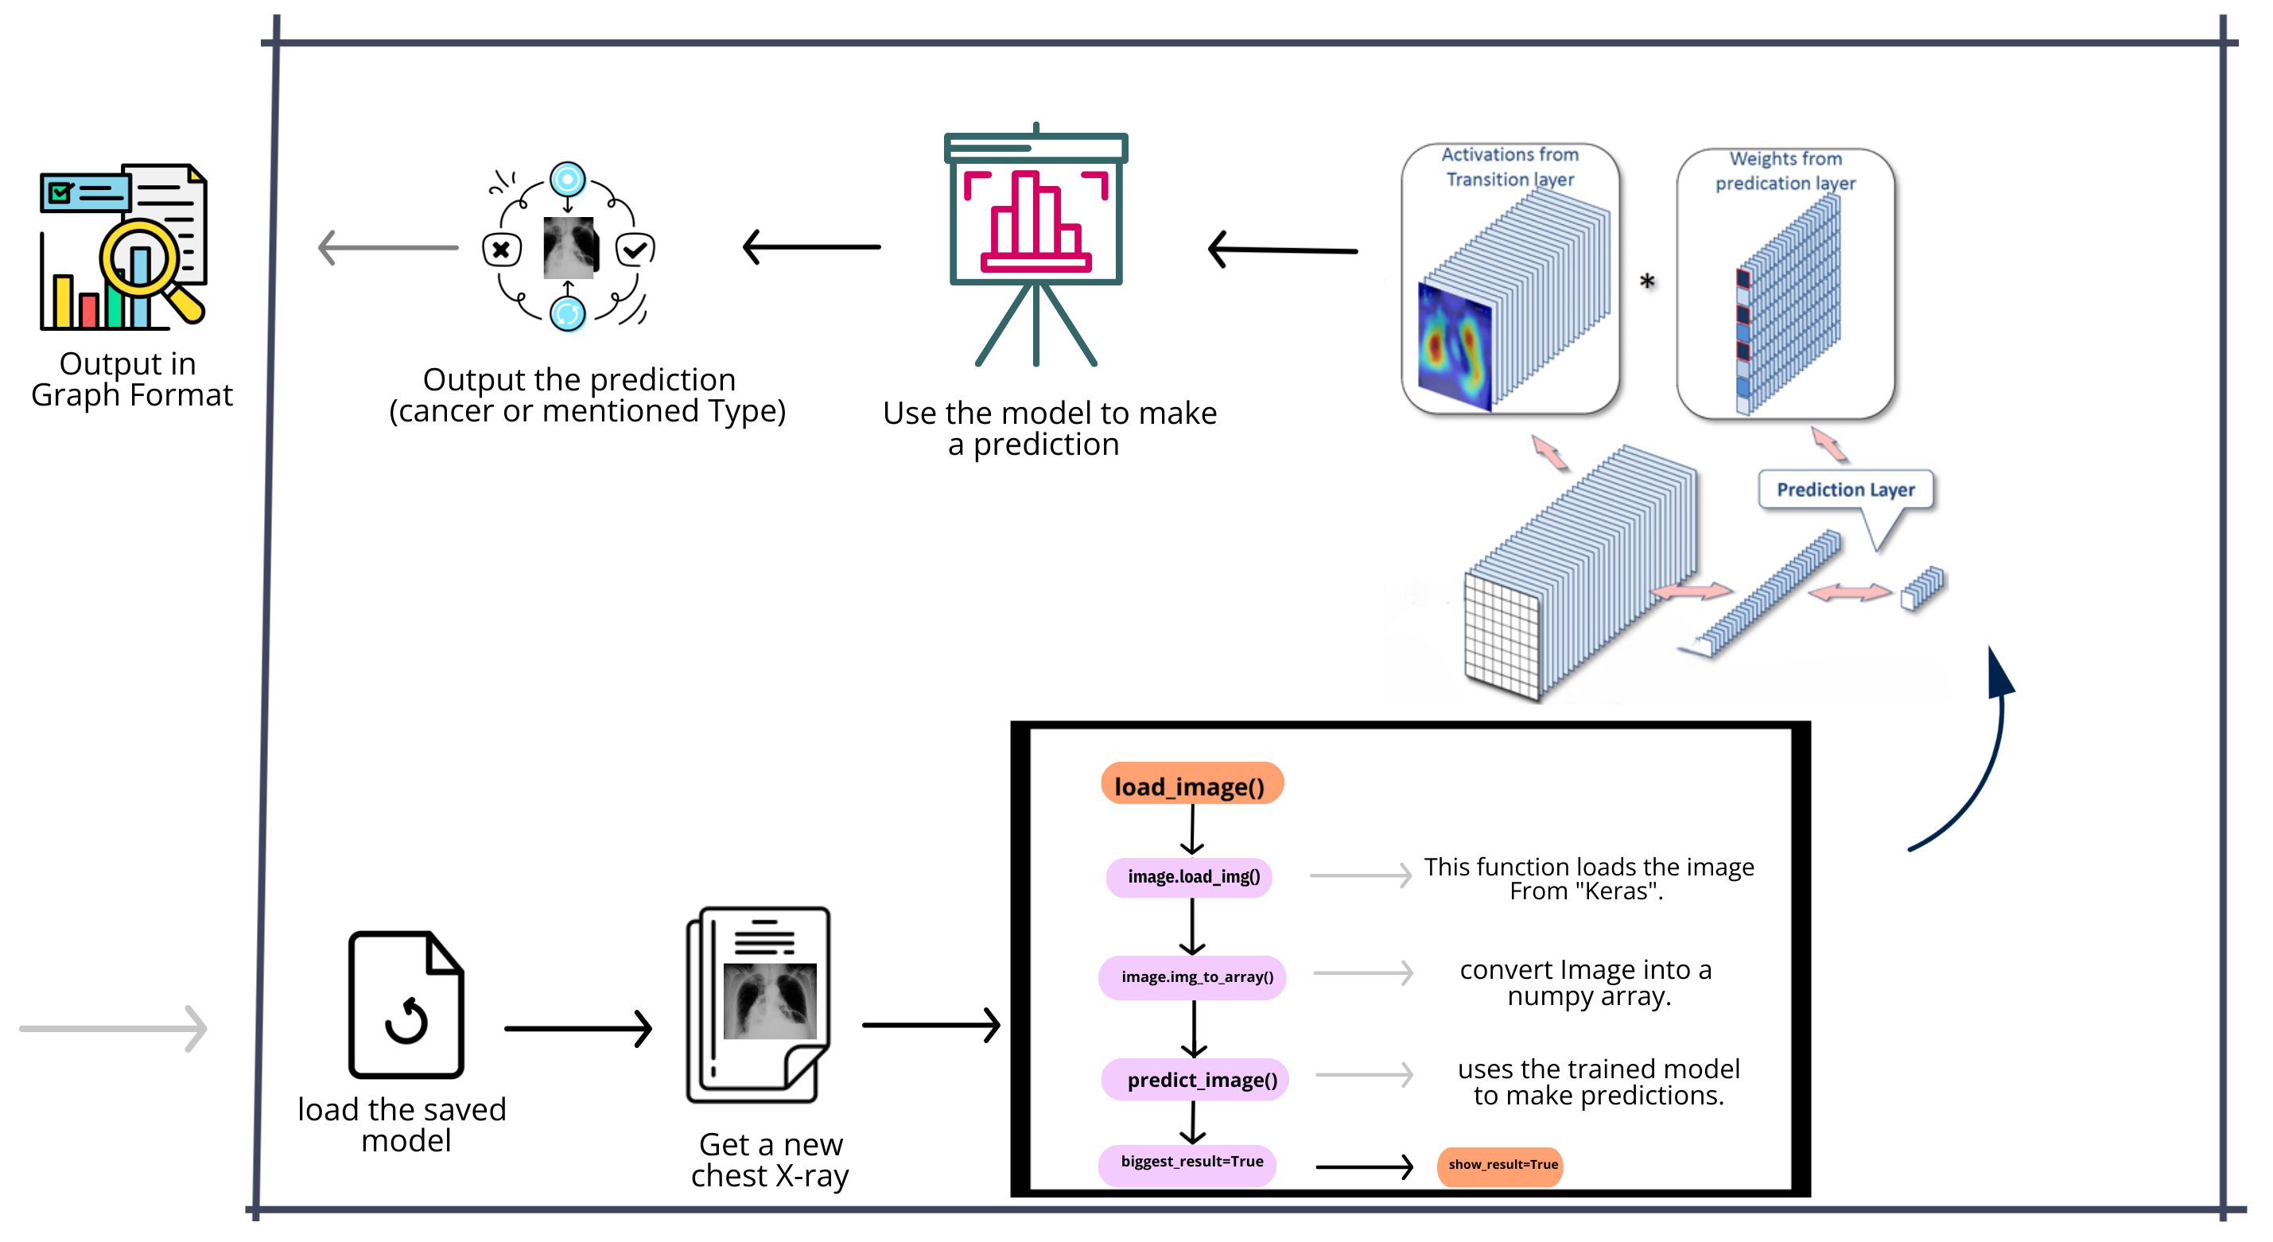
CODE_AKATSUKI
Working of Project

Slide 8
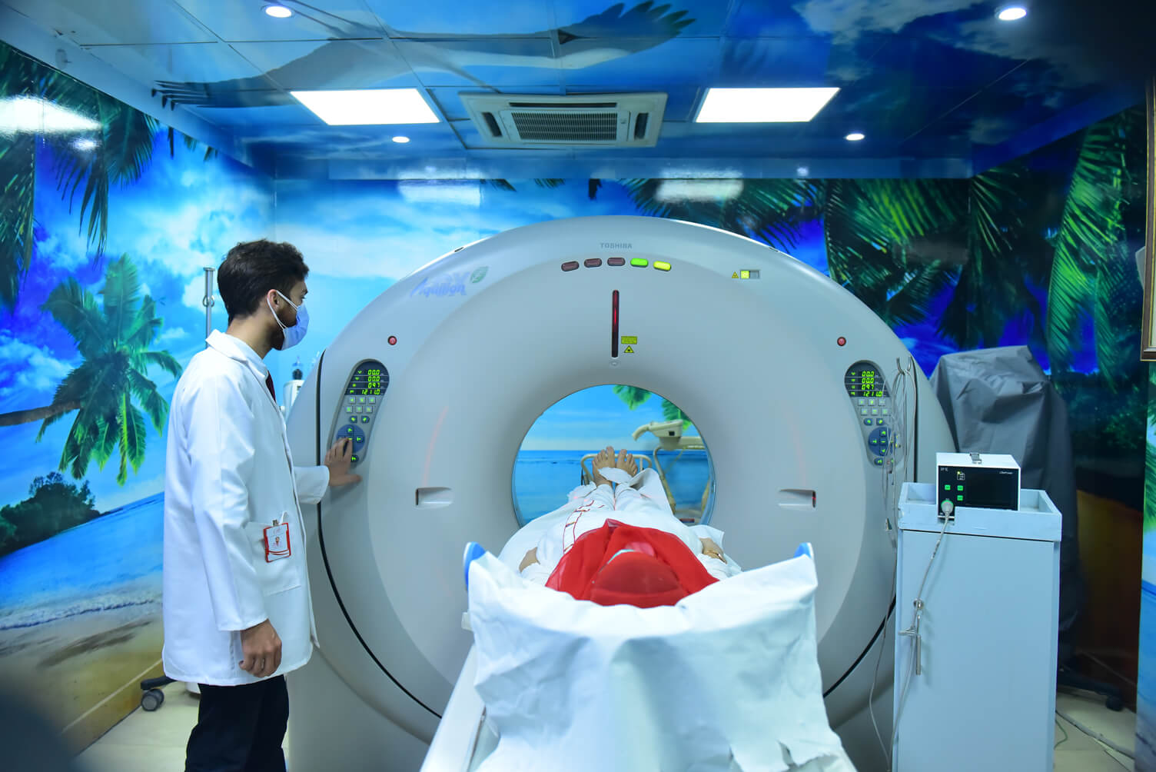
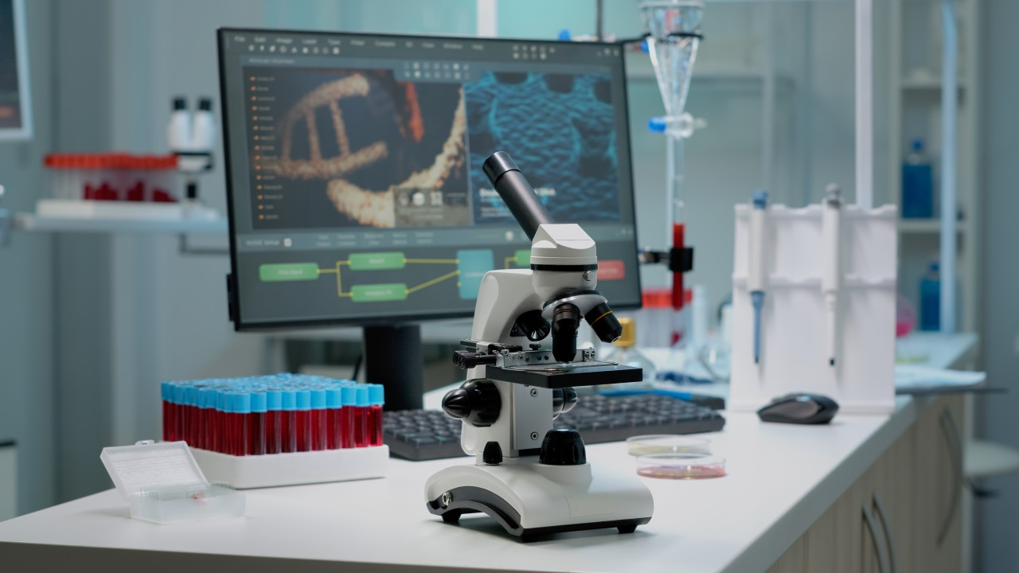


CODE_AKATSUKI
Related Application for business model
Other Diseases detection using
HRCT Scan
Personalized Cancer Treatment Plans using Genomic Data
Cancer Support Chabot for Patients and Caregivers
Smart Wearable's for Monitoring Cancer Patients

Slide 9
CODE_AKATSUKI
Market Analysis
1. Key factors driving growth:
Increasing incidence of lung cancer due to rising smoking population.
No Awareness about technology
No Government support for early detection.
2. Target Market Segmentation
Institutions (60%),
research institutions and universities (20%),
pharmaceutical companies for clinical trials (10%),
individuals at high risk (10%).

Slide 10
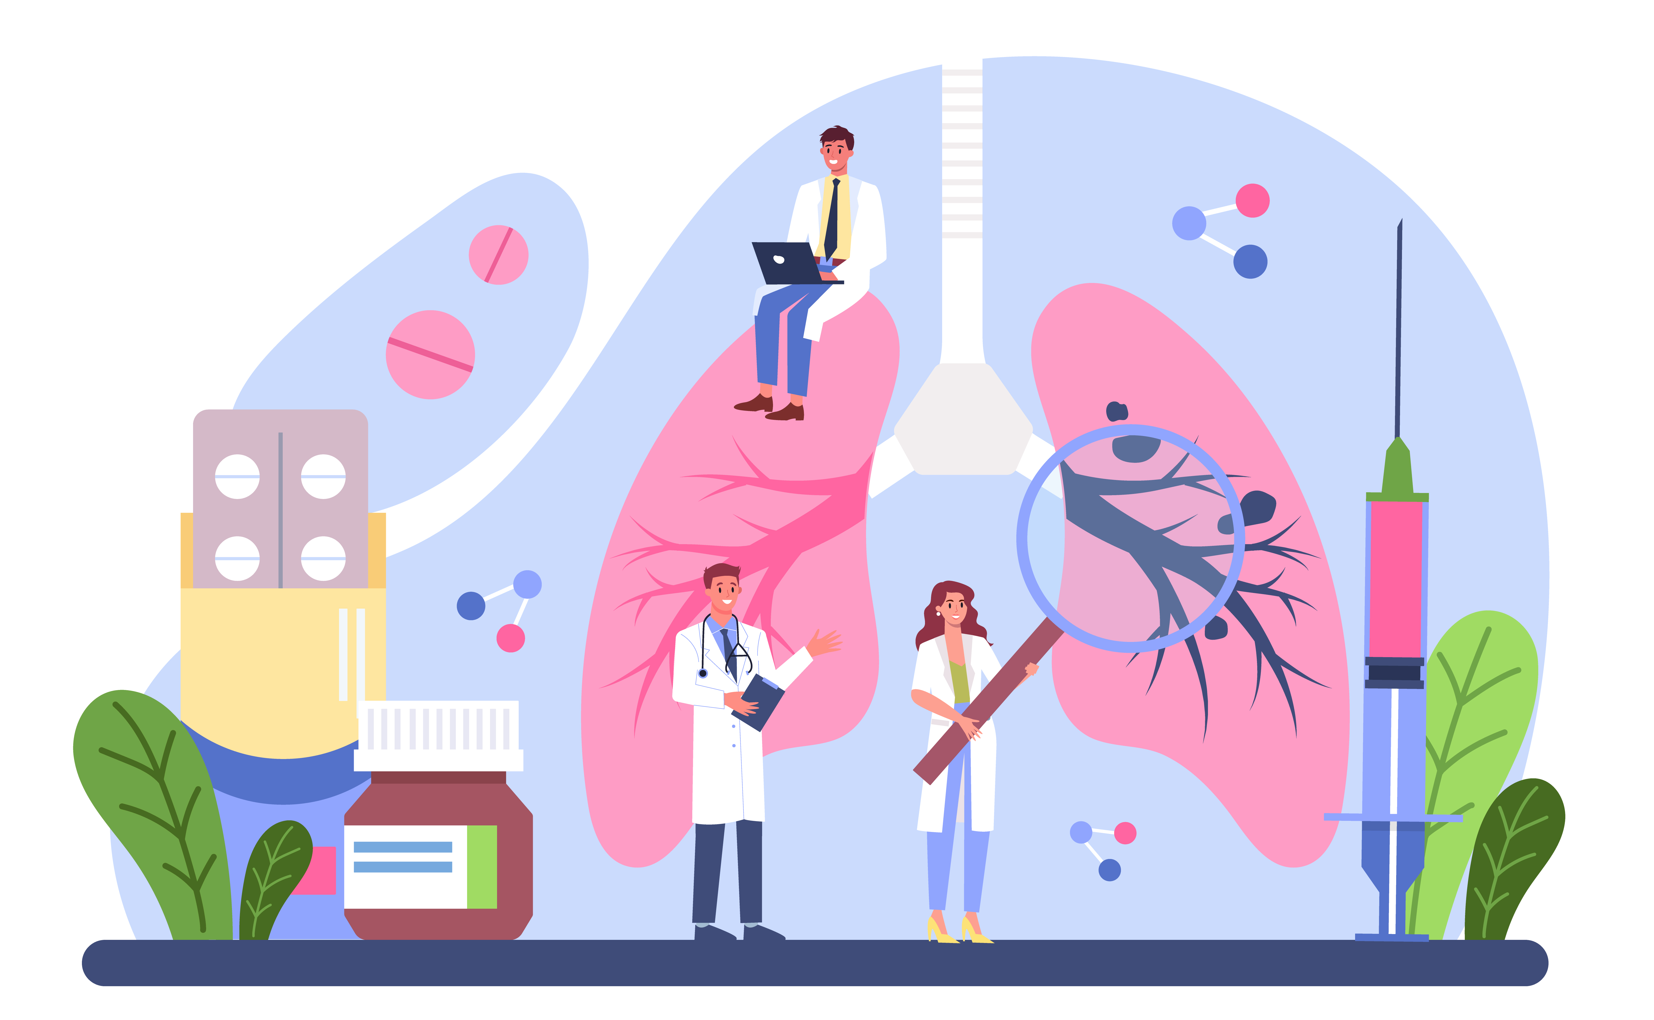
Doctor Consultation
CODE_AKATSUKI
Well Response for Real time and Random Images from web
Comparison with current Available System
Good References for pursuing Student and Unexperienced Doctors For Study

Slide 11
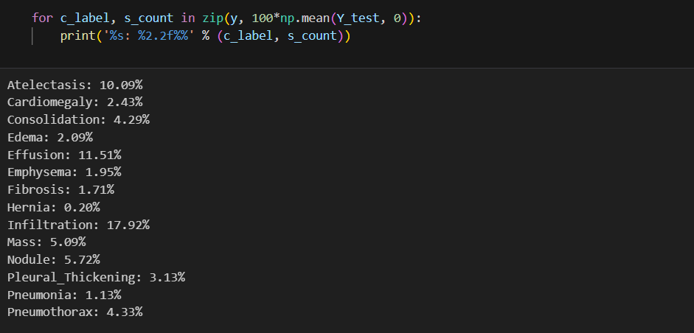
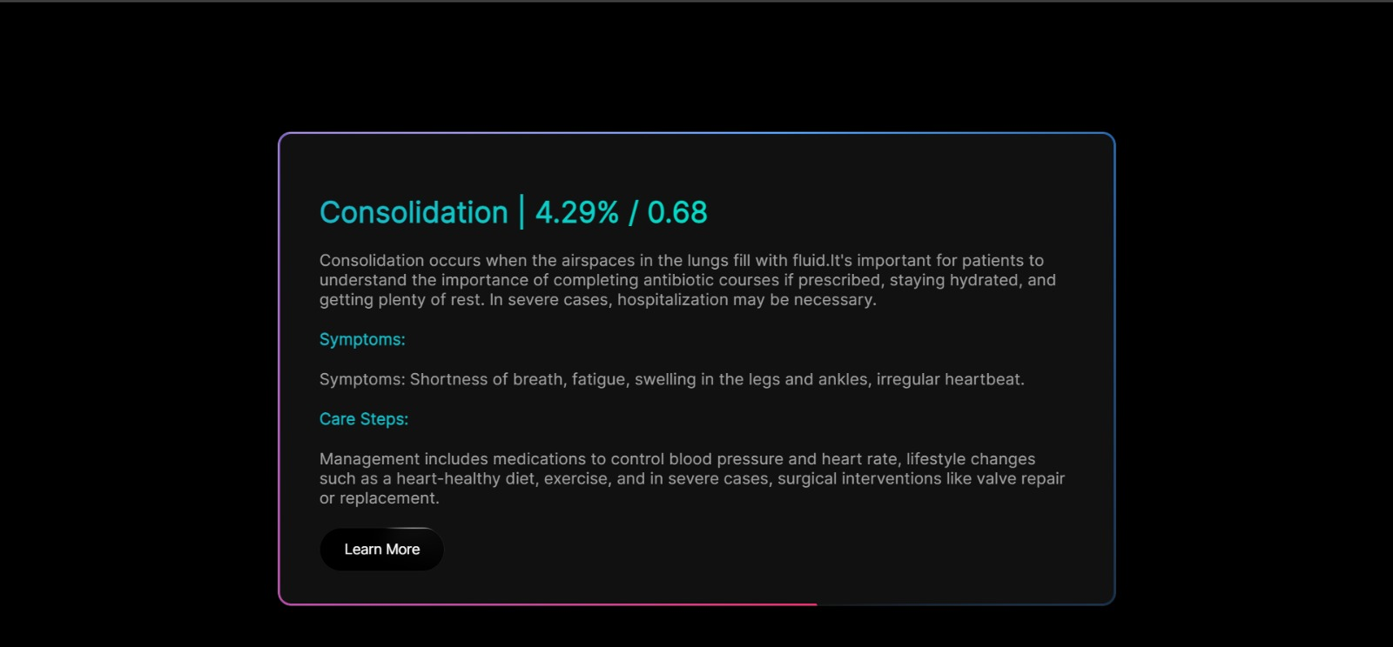
CODE_AKATSUKI
Standard Values

Slide 12
Conclusion
CODE_AKATSUKI
Under Doctor Consultancy
Current condition of lungs cancer treatment in India
This idea will make revolutionary in medical diagnosis because of AI and ML
This is very affordable and time saving idea of early lungs cancer detection and diagnosis

Slide 13

Team Members
CODE_AKATSUKI

Slide 14

THANK YOU!
Sandesh Pol
Phone:
9067248106
Email:
sandeshpol268@gmail.com

